Slide 1

Sales Module in Dynamics 365

Slide 2

Agenda
Importance of Dynamics 365 Sales
Dynamics 365 Sales components
OOB Sales Life Cycle (A typical process of sales from start to end)
Lead Qualification Process
Lead Reactivation Process
Opportunity Management
Quote management
Order and Invoice management
System Pricing Calculations in Dynamics 365
BizAppsGuru video links
Product Catalog
FAQs

Slide 3
Importance of Dynamics 365 Sales
A typical sales process includes a set of repeatable steps that sellers follow to engage with a prospective customer from the early stage of awareness to closing a sale. You can achieve more consistent sales interactions by following the sales process as it takes you through each stage, from creating a lead to closing the opportunity and recording the sale.
With the Dynamics 365 Sales, your sales organization can automate the sales process from lead to invoice, run marketing campaigns, enforce best practices, collaborate with customers, and much more.

Slide 4
Importance of Dynamics 365 Sales
Below are the major capabilities from Dynamics 365 Sales:
Nurture sales from lead and cash: Achieve more consistent sales interactions by following the sales process as it takes you through each stage, from creating a lead to closing the sale.
Forecast sales: Predict how much revenue your sales team will generate in a given timeframe using Sales Forecasting.
Run and track marketing campaigns: Promote your business and improve sales with targeted marketing campaigns. Track customer response and costs for each campaign.
Relationship Assistant: Get actionable insights and suggestions based on how you work. For example, if you have an opportunity closing next week, the Relationship Assistant will send you a reminder to connect with your customer.

Slide 5
Importance of Dynamics 365 Sales
Reference link:
https://docs.microsoft.com/en-us/dynamics365/sales/overview

Slide 6
Dynamics 365 Sales components
Lead: Lead is someone with an interest in what you are selling.
Someone who has expressed interest by requesting more information on your website.
Someone who is following a post that you or your organization is making on social media.
Someone who responded to an advertising or email campaign or showed interest in tradeshow.
Account: An account represents a business or organization. Sometimes this is a customer or a vendor, typically account have related contact record. E.g. mostly used in B2B relationship.
Contact: A contact represents a single individual. A contact record can be a standalone record, or it can be associated with an organization. A contact will often have many related records such as an account and activities. E.g. mostly used in B2C relationship.
Customer: A customer can be either an account or a contact. Typically speaking, in a B2B scenario, this is an account. In a B2C scenario, this is a contact. E.g. If hybrid B2B and B2C business relationship. “Potential Customer” field on Opportunity.

Slide 7
Dynamics 365 Sales components
Activities: An activity is a type of entity that offers tracking and scheduling options. By default, the system will have activities such as email, appointment, and phone call already configured.
Opportunity: Qualified lead converts into opportunity record.
Quote: A formal offer for products or services, proposed at specific prices and related payment terms to a customer.
Order: Once quote accepted order placed.
Invoice: An order or record of sales including details about products or services purchased that has billed to the customer.

Slide 8
Dynamics 365 Sales components
Product CatLog: A collection of records that interact with opportunities, quotes, orders, and invoices to facilitate management of products, price lists, discounts, and product families for sales transactions.
Business process flow: The BPF placed on an entity and offers users guidance and a predictable action plan for gathering data. It works as checklist for the salesperson which guides throughout containing different BPF stages (each stage consist of different steps) placed in logical sequence.

Slide 9
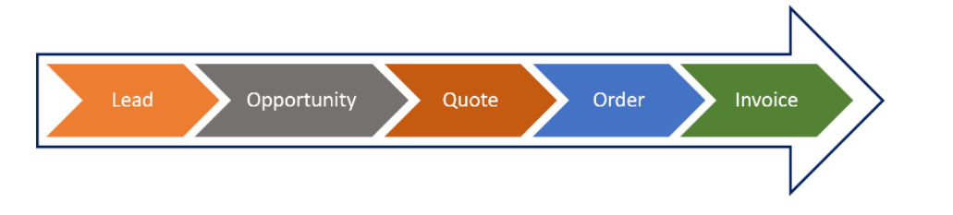
OOB typical Sales Life Cycle
Dynamics 365 Sales enables an organization to manage their sales lifecycle process from start to finish. A typical sales lifecycle would resemble the image below:
Your sales process begins with a lead—someone who is interested in the products or services you provide. Your leads might be automatically generated or they might come from other sources, such as website opt-in pages, email queries, or business cards that you gather at trade shows.

Slide 10
OOB typical Sales Life Cycle
When Lead qualified Opportunity, Account, Contact created in D365 (NOTE: First Name and Last Name fields of lead turns to be Full Name of Contact and Company name field of lead turns to be Name of Account), Opportunity also called as deal which has estimated revenue defined and while closing the opportunity it has actual revenue defined. This is the entity record which stays longer in system and Sales team spend most of the time to understand the deal carefully. Once opportunity work completed sales team generates the quote from opportunity once formal quote presented and get accepted by customer, then order placed and after fulfilling the order next step is Invoice generation.

Slide 11
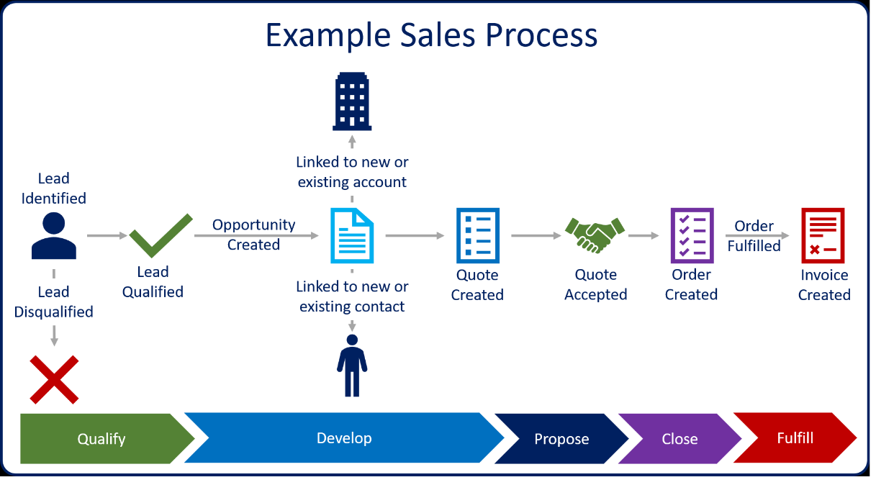
OOB typical Sales Life Cycle
More detailed pictorial view as shown below:

Slide 12
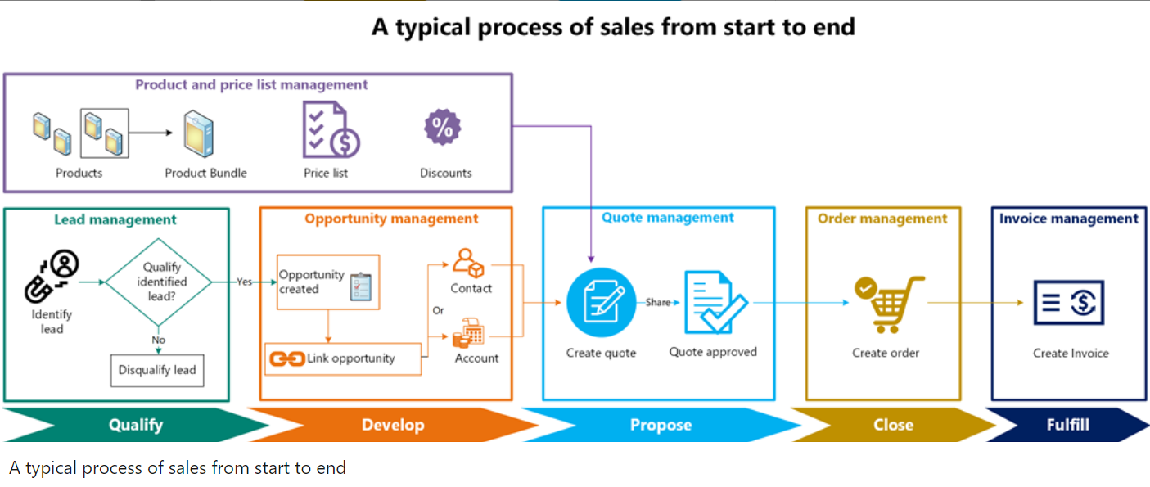
OOB typical Sales Life Cycle
More detailed pictorial view as shown below:

Slide 13
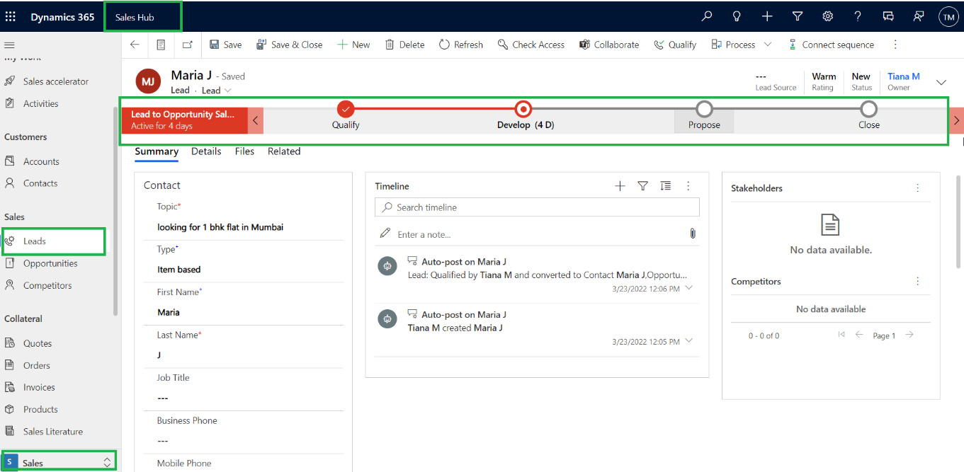
OOB typical Sales Life Cycle
Open your trial instance --> From the App switcher select Sales Hub --> Under Sales Area--> Navigate to Leads and open the existing lead record, you will find “Lead to Opportunity Sales Process” BPF as shown below When a user starts using BPF the stages and steps of the process are displayed in the process bar at the top of a form:

Slide 14
OOB typical Sales Life Cycle
You can help ensure that people enter data consistently and follow the same steps every time they work with a customer by creating a business process flow, Business process flows reduce the need for training because new users don’t have to focus on which table they should be using. They can let the process guide them.
As highlighted above typical business process flow (BPF) consist of below stages:
Qualify
Develop
Propose
Close

Slide 15
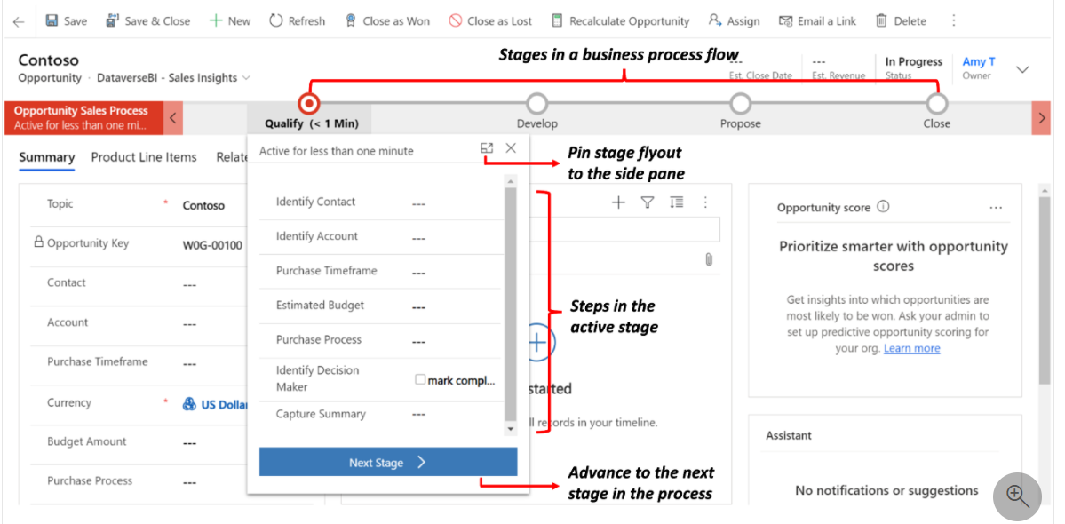
OOB typical Sales Life Cycle
Each stage consist of set of defined steps to be completed by salesperson, it works as checklist to salesperson by which important fields can be captured from prospect at early stage.

Slide 16
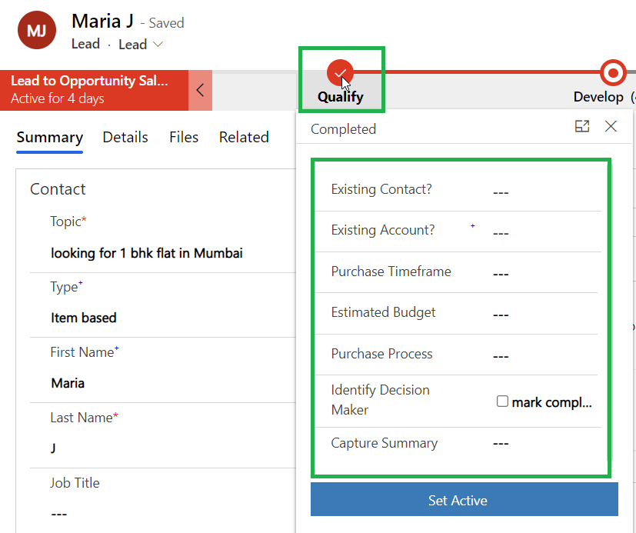
OOB typical Sales Life Cycle
NOTE: You can move forward and backwards in the business process by using Next Stage button. The active stage in BPF indicated by the position of the “double circle” icon in the process bar. As shown above “Qualify” is the current stage, when lead qualifies the current stage becomes “Develop”.
For example when you click on Qualify stage, then steps under it opens up for Salesperson as below:

Slide 17
OOB typical Sales Life Cycle
Qualify: Once you create the Lead in D365 by default it is on Qualify stage where Salesperson works with Lead to understand their needs better. Once salesperson identified that this lead has appropriate purchasing power then he qualifies the lead. Qualifying a lead in Dynamics 365 Sales converts it to an opportunity.
Develop: Once opportunity created from lead, on lead form you will experience current stage as Develop. The opportunity record is used to develop the details of the deal. Details such as the products and services they are interested in, estimated revenue, and time-lines like estimated closed date are added to the opportunity

Slide 18
OOB typical Sales Life Cycle
Propose: Once salesperson spent sufficient time on Opportunity, then now it's time to present your formal proposal (Quote) to your potential customer (Account or Contact). Which may or may not be asked for revision from customer. If asked for revision then salesperson can again present the revised Quote and try to close the deal.
Close: When the customer agrees to the quote, an order is generated. The quote and opportunity associated with the order are closed, after the order is fulfilled, an invoice is generated to bill the customer.

Slide 19
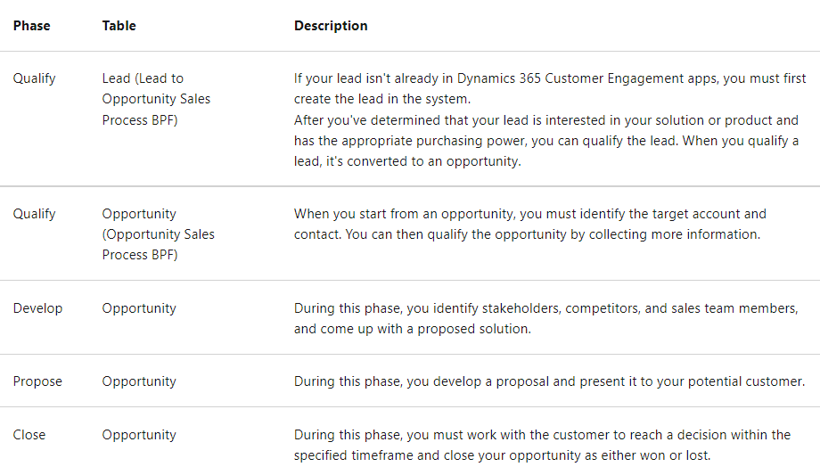
OOB typical Sales Life Cycle
The summary of the BPF stages summarized as below:

Slide 20
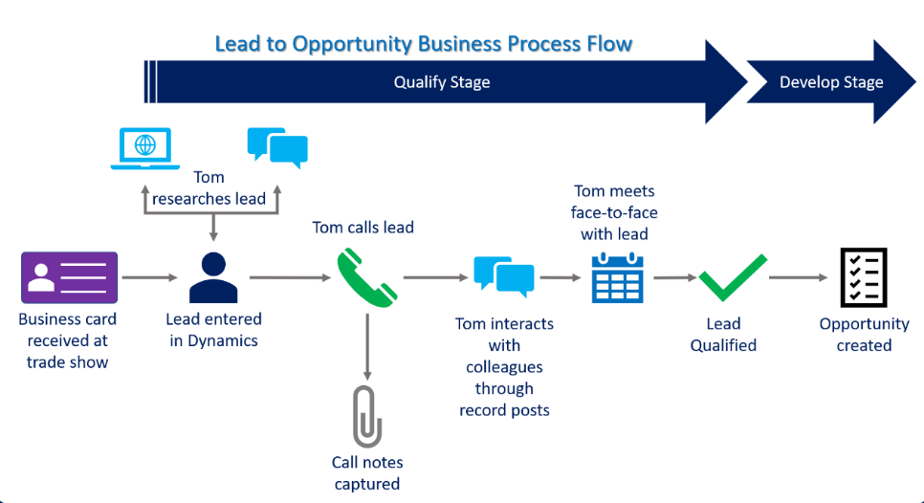
Lead Qualification Process
When lead is qualified, the following values on the Lead record page control the outcome of the qualification process:
Name (First Name and Last Name): If this value entered, it becomes the full name of the new contact.
Company: This value becomes the name of the newly created account using the company name.

Slide 21
Lead Qualification Process
When lead is qualified, the following value on the Opportunity record page control the outcome of the qualification process:
Title: This value comes from Title of the lead.
Originating Lead: This value populated with the qualified Lead record.
Existing Account: This value populated with the Account created.
Existing Contact: This value populated with the Contact created.

Slide 22
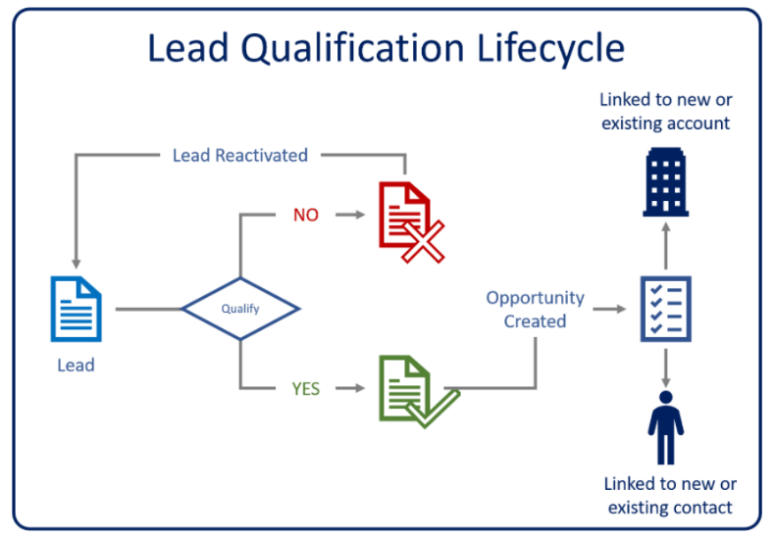
Lead Qualification Process
The Lead Qualification Lifecycle:

Slide 23
Lead Qualification Process
It is important to observe the status and status reason of the Lead form throughout the lead lifecycle. For e.g. when Lead created the Status of Lead form is Open and you can edit the form as form is editable. But once qualified/disqualified the Status of Lead becomes Qualified/Disqualified and you cannot edit the form as form is non editable (Read only).
Below is the summarized table depicting status and there corresponding status reasons and form behaviour:
Status | Status Reason | Comment
Open | New, Contacted | Editable form
Qualified | Qualified | Read Only form
Disqualified | Lost Cannot contact No Longer Interested Cancelled | Read Only form

Slide 24
Lead Reactivation Process
By clicking on disqualify button from command bar you can disqualify the lead.
Occasionally, a lead that previously disqualified might need to reactivate. This might occur when, for example, someone who was not previously interested in your organization's products or services is now interested.
Reference link:
https://docs.microsoft.com/en-us/learn/modules/manage-leads-dynamics-365-sales/

Slide 25
Opportunity Management
An opportunity is a qualified lead who is now almost ready to buy—in other words, a deal that you're ready to win.
When you create an opportunity manually, you must specify an existing account or contact record. When opportunity created through the Lead qualification process then existing Account and/or contact gets linked to opportunity from lead.
With an opportunity, you can forecast important data like:
Sales revenue (Estimated revenue, Actual Revenue),
Set a potential close date (Estimated close date, Actual close date)
Factors in a probability for the sale to occur.

Slide 26
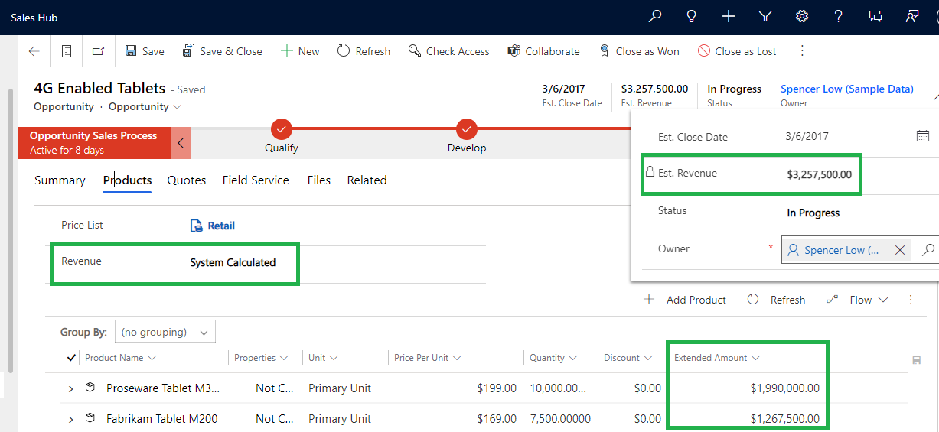
Opportunity Management
Pricing calculation depend upon the option you select in Revenue field. There is two option set field on opportunity entity called “Revenue”.
Either let the system calculate the revenue of the Opportunity based on the Product Line Items (System Calculated) or you can enter yourself or add your own custom logic to it (User Provided).
If Revenue= System Calculated
When you select System Calculated, the Est. Revenue field is locked and the Revenue is calculated from the Product Line Items.

Slide 27
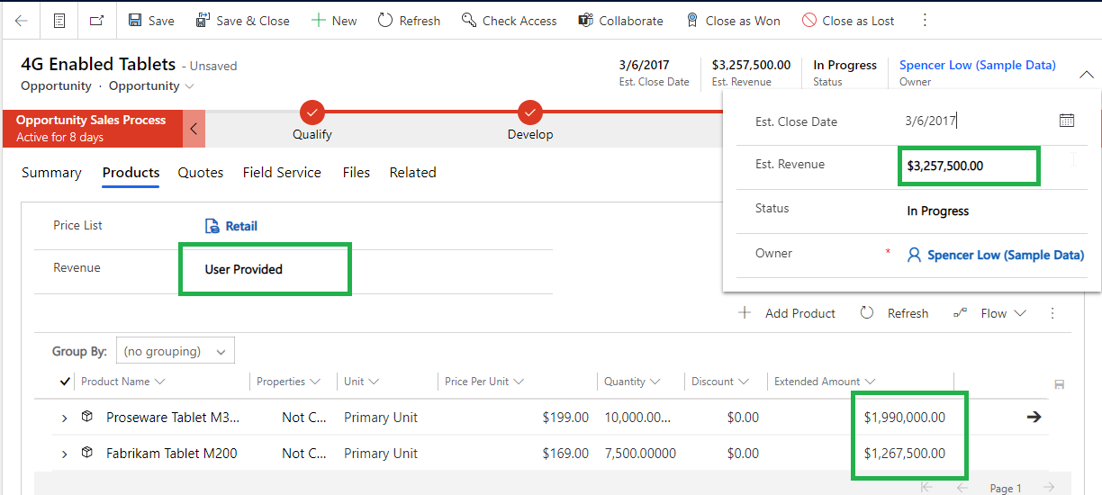
Opportunity Management
If Revenue=User Provided
When you select User provided, the Est. Revenue field is unlocked and the Est. Revenue is open to enter data into it.

Slide 28
Opportunity Management
Opportunity Lifecycle
Reference link:
https://docs.microsoft.com/en-us/learn/modules/manage-opportunities-dynamics-365-sales/4-opportunity-management-lifecycle
Status | Status Reason | Comment
Open | In Progress On Hold | Editable form
Won | Won | Read Only form
Lost | Cancelled Out-Sold | Read Only form

Slide 29
Quote Management
Quotes are record by which formal quotation/pricing are offered for the products to a customer.
Life-Cycle
Status(State code) | Status Reason (Status code) | Comment
Draft | In Progress | Editable form
Active | In Progress or Open | Read Only form. It can be won or closed or revised
Won | Won | Read Only form status become won when associated with an order
Closed | Lost, Cancelled or Revised | Read Only form. It can be revised only if previously draft or active quote with same quote number does not exist.

Slide 30
Quote Management
Draft
When quotes created, they are in draft status.
Draft quotes are editable.
Draft quotes need to be activated before progressing.
Active
Active quotes can be printed and presented to the customer.
Active quotes are read-only.
Orders created from an active quote by clicking on Create Order button.
Active quotes can be marked as won or lost.
Active quotes available for revision. Which closes the current version and creates a new version of the quote in a draft status and revision ID of next quote get incremented by 1.

Slide 31
Quote Management
Won
Status changes to won when quote accepted by customer. Simply when order is placed means we won the quote.
Won quotes are read-only.
Closed
Quotes can be closed because they have been lost, cancelled or revised.
Closed quotes are read-only.
Reference link:
https://docs.microsoft.com/en-us/learn/modules/process-sales-orders-dynamics-365-sales/2-quotes-and-quote-management

Slide 32
Order and Invoice Management
When customer accept the quote. That is when we win the quote. We convert the quote into order. The process of converting a quote to an order is done by selecting the Create order button on the command bar.
When the order is created, the contents/information of the quote are added to the order record and the quote is won also system won the corresponding opportunity as “Close Opportunity” is set as yes.
NOTE: Actual revenue field on opportunity calculated from the quote as “Calculate actual revenue from quotes” is set as Yes.

Slide 33
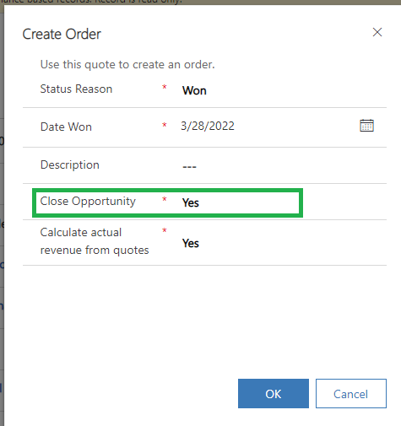
Order and Invoice Management

Slide 34
Order and Invoice Management
The Order Lifecycle
Status(State code) | Status Reason (Status code) | Comment
Active | New, Pending, On hold | Editable form
Cancelled | No Money | Read Only form
Fulfilled | Complete, Partial | Read Only form

Slide 35
Order and Invoice Management
The Invoice Lifecycle
When Order fulfilled, by clicking on “Create Invoice” button Invoice get created for requesting the payment from customer.
Note: Confirm Invoice set the status reason as Billed.
Reference link:
https://docs.microsoft.com/en-us/learn/modules/process-sales-orders-dynamics-365-sales/3-orders-and-invoices
Status(State code) | Status Reason (Status code) | Comment
Active | New, Partially shipped, Billed | Editable form
Cancelled | Cancelled | Read Only form
Paid | Complete, Partial | Read Only form

Slide 36
System Pricing Calculations
System pricing calculation work on below fields:
On Quote/Order Products: Price Per Unit, Volume Discount, Amount and Extended Amount.
On Quotes/Orders: Detail Amount, Pre-Freight Amount, Total Amount, Total Line Item Discount Amount, and Total Discount Amount.

Slide 37
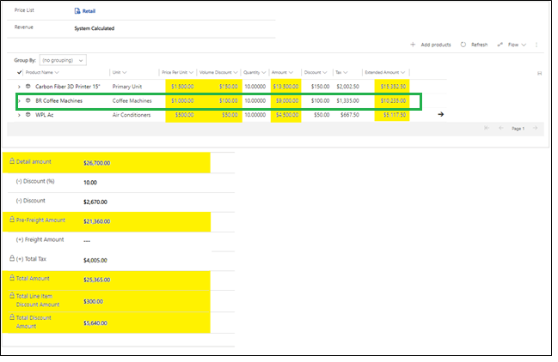
System Pricing Calculations
NOTES:
On Quote/Order Products the Tax is not system calculated.
By default, the Total Line Item Discount Amount and Total Discount Amount are not displayed on the Quote/Order form.

Slide 38
System Pricing Calculations
The pricing fields for Quote/Order products are calculated as follows:
Price per unit:
When the Pricing option is set to ‘Use Default’, the Price Per Unit is calculated based on the configuration of the Price List Item identified using the Price List on the Quote/Order, the Product and the Unit on the Order/Quote Product.
The Pricing Method configured on the Price List Item could be one of the following:
• Currency Amount • Percent of List (i.e. Percent of List Price) • Percent Mark-up (of either Current Cost or Standard Cost) • Percent Margin (of either Current Cost or Standard Cost)
When the Pricing option is set to ‘Override Pricing’, as is the case when adding a Write-In Product to the Quote/Order, the Price per Unit must be manually entered by the User.

Slide 39
System Pricing Calculations
2. Volume Discount
The Volume Discount is calculated if a Discount List is associated with the Price List Item and the Quantity falls within one of the Quantity Breaks configured in the Discount List.
Discount Lists may be configured to apply the same Discount or different Discounts based on Quantity.
The calculated Discount is a Discount on the Price per Unit and may be configured as a Percentage or as an Amount. If the Price per Unit is $1,000 and the Quantity is 10 and the Discount List associated with the Price List Item provides a 10% Discount or a $100 Discount for the specified Quantity, then the Volume Discount will be $100.
3. Amount
The Amount is (Price per Unit - Volume Discount) * Quantity; e.g. ($1000 - $100) * 10 = $9,000.

Slide 40
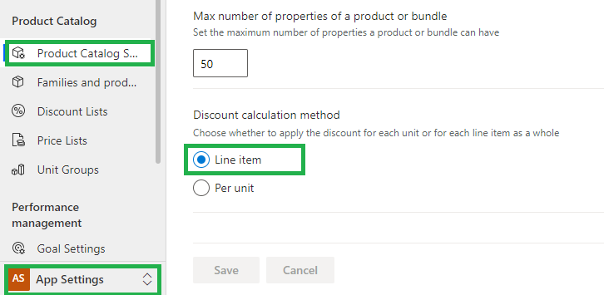
System Pricing Calculations
4. Extended Amount
There are two methods by which the Extended Amount might be calculated depend on the ‘Discount Calculation Method’ setting selected under App Settings.
By default, this setting is configured as ‘Line Item’ and results in the Extended Amount being calculated as explained:

Slide 41
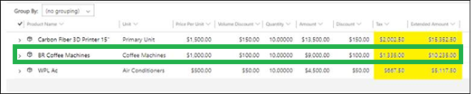
System Pricing Calculations
• (((Price Per Unit - Volume Discount) * Quantity) - Discount Amount) + Tax; e.g. (($1,000 - $100) * 10) - $100) + $1,335 = $10,235. Note: In this example, the pre-Tax amount is $8,990.

Slide 42
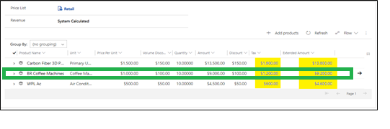
System Pricing Calculations
However, if the ‘Discount Calculation Method’ setting is set to ‘Per Unit’, then the Extended Amount is calculated as follows:
• (((Price Per Unit - Volume Discount) * Quantity) - (Quantity * Discount Amount)) + Tax; e.g. (($1,000 - $100) * 10) - (10 * $100)) + $1,200 = $9,200. Note: In this example, the pre-Tax amount is $8,000.
NOTE: The difference between the ‘Line Item’ calculation and the ‘Per Unit’ calculation is the addition of the Quantity as a multiplier of the Discount Amount.

Slide 43
System Pricing Calculations
The pricing fields for Quotes/Orders are calculated as follows:
Detail Amount
The Detail Amount is the sum of the ((Amount - Discount) + Tax) from all the related Quote/Order Products; e.g. $26,700. The Detail Amount is Tax Exclusive, i.e. it is not the sum of the Extended Amount from all the related Quote/Order Products.
Pre Freight Amount
The Pre-Freight Amount is (Detail Amount - Discount Percent) - Discount Amount; e.g. ($26,700 - 10%) - $2,670 = $21,360.
It is important to know that the Discount Percent is subtracted prior to the Discount Amount.
3. Total Tax
The Total Tax is the sum of the Tax from all the related Quote/Order Products; e.g. $4,005.

Slide 44
System Pricing Calculations
4. Total Amount
The Total Amount is Pre-Freight Amount + Freight Amount + Total Tax; e.g. $21,360 + $0 + $4,005 = $25,365.
5. Total Line Item Discount Amount
The Total Line Item Discount Amount is the sum of the Manual Discount from all the related Quote/Order Products; e.g. $300.00
6. Total Discount Amount
The Total Discount Amount is the sum of the Total Line Item Discount Amount + Discount Percent + Discount Amount; e.g. $2,670 + $2,670 + $300 = $5,640.

Slide 45
Other References: BizAppsGuru Video links:
https://www.youtube.com/watch?v=LLxBzRETYKU&list=PLjsvdMzSVSzXqJcIZyKjg5W79wIKIAnvQ&index=2
https://www.youtube.com/watch?v=xIS7xxnxtNY&list=PLjsvdMzSVSzXqJcIZyKjg5W79wIKIAnvQ&index=3
https://www.youtube.com/watch?v=7YJZJEZzFdI&list=PLjsvdMzSVSzXqJcIZyKjg5W79wIKIAnvQ&index=6

Slide 46
Product Catalog
Product Catalog Introduction
Components of the Product Catalog
Define Price list item and Pricing Method
Re-parenting a product
Product properties and Relationship
Publishing, Cloning, Revising, and Retiring Products
Prices Calculations for Product Bundles
Enhanced experience for adding products
Product Catalog settings
Price Calculation for Opportunity, Quote, Order, and Invoice records

Slide 47
Product Catalog Introduction
A product Catalog is a collection of products and services that an organization sells and provides to customers. It includes pricing information. A typical product catalog not only includes a list of the products that an organization sells but also defines different pricing tiers, like retail and wholesale, and quantity levels on how a product will be sold.
Microsoft Dynamics 365 includes a product catalog that lets organizations create a rich product classification system that supports the following actions:

Slide 48
Product Catalog Introduction
Define a hierarchical structure of product families and products that have configurable properties (attributes). These attributes help you reduce the number of product stock-keeping units (SKUs) that are required to maintain your product catalog.
Sell individual products, or group them into bundles and kits. A bundle or a kit is a collection of products that are sold as a single unit. Product bundling is useful for grouping products in such a way that customers will benefit from the full line of products. It also lets you offer discounts on bundled products.

Slide 49
Product Catalog Introduction
Define related products in the system. (For example, these related products might be the substitute, cross-sell, up-sell, or accessory products.) The related products for a product are shown to sales agents as suggestions when they add the product to an opportunity, quote, order, or invoice.
Define multiple pricing and discounting models. You can also use custom pricing instead of the Dynamics 365 system pricing to calculate prices when you associate a product or bundle with an opportunity, quote, order, or invoice. Additionally, you can select whether to apply discounts for products at the per-unit level or the line level.

Slide 50
Product Catalog Introduction
Specify whether the price level (that is, the price list) should be automatically set for an opportunity, quote, order, or invoice, based on the user's sales territory relationship.
Specify localized values for some product properties (attributes) to make the product names and descriptions available in user-preferred languages.

Slide 51
Components of the Product Catalog
The Dynamics 365 product catalog consists of four components:
Unit groups:
A unit group defines how a product is packaged for sale. Among other values, it defines the units of measure that the product or service is sold in. For example, an organization that sells gaming systems might sell them individually on a crate that includes 12 individual gaming systems. An organization that provides services to customers might sell its services in increments of hours, days, or weeks.
Products:
A product represents the type of product that a company might keep in inventory, a custom-built product, or a service that's provided to a customer. For example, a beauty salon's product list might include different hair styling products and also services like haircuts, hair colouring, and spa services.

Slide 52
Components of the Product Catalog
Price lists:
A price list is a set of prices that are charged for products under specific circumstances. For example, an organization might have multiple price lists to accommodate seasonal variations, specials, or the different markets that the organization sells to (like government, commercial, and education).
Discount lists:
A discount list lets organizations offer products or services at different prices, depending on the quantity that's bought. For example, a small vendor that buys five TVs to sell in its store might pay 350.00 US dollars per TV. A large vendor that buys 500 TVs to sell in multiple locations might pay 300 US dollars per TV.

Slide 53
Components of the Product Catalog
Note: Of all the components in the preceding list, only discount lists aren't required. All other components must be set up for any organization that will use the product catalog.
Because of the way that units, discounts, and prices are linked, you must create the components in a product catalog in the following order.
Reference Link: https://docs.microsoft.com/en-us/dynamics365/sales/set-up-product-catalog-walkthrough

Slide 54
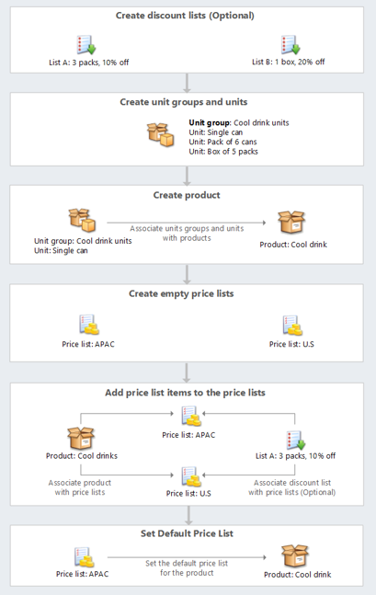
Components of the Product Catalog

Slide 55
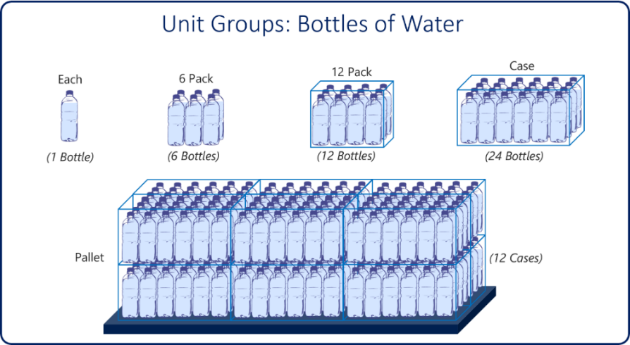
Unit Groups
Before products can be defined, an organization must define units to define how its products can be sold. Units are the quantities or measurements in which you sell your products or services in. For example, an organization that sells gardening supplies might sell seeds in individual packets, boxes that have multiple packets, or pallets that have multiple boxes. Each one of those selling options represents a unit. A unit group is a collection of these different units.
Let's look at another example, where an organization sells bottles of water.

Slide 56
Unit Groups
A unit group has been created to define how bottles of water can be sold. A single bottle of water is represented by a unit of each. Each additional unit represents different quantities of units:
Each: This unit represents a single bottle of water.
6-pack: This unit represents six bottles of water.
12-pack: This unit represents twelve bottles of water.
Case: This unit represents 24 bottles of water.
Each of these units is based on single quantities. But your organization might also sell to wholesalers who deal in larger quantities. To handle this scenario, you can define a unit that's, a pallet, that represents 12 cases of water.

Slide 57
Unit Groups
To define unit groups, go to App Settings in the Sales Hub app. For every unit group, a primary unit is defined. The primary unit usually represents a single quantity of the item that's being sold. Additional units that are added are then based on a specific number of base units. For example, an organization that sells services might define an hour as the primary unit for a unit group. This organization can then define a second unit, day, that represents eight hours.
The following table expands on this example.
Unit name | Base unit | Quantity (Base units)
Hour (Primary unit) | Not applicable | 1
Day | Hour | 8
Week | Day | 5
Month | Week | 4

Slide 58
Unit Groups
After the different unit groups that should be available have been defined, they can then be associated with individual products as they're created.
Reference Link: https://docs.microsoft.com/en-us/dynamics365/sales/create-unit-group-add-units-that-group

Slide 59
Unit Groups
UnitA Unit defines a specific quantity or measurement of a product. For example:
"Piece"
"Box"
"Dozen"
"Kilogram"
Each product is sold in one or more units, and each unit can have different pricing or quantities.
Example:
Product: Luxury Watch
Unit: Piece (1 watch)
Unit: Box (contains 10 watches)

Slide 60
Unit Groups
A Unit Group (also known as UoM Schedule in some versions) is a collection of units that are related to each other and define how those units convert among each other.
Each product must be assigned to a Unit Group, and that group defines all the ways that product can be sold.
Example:
Unit Group: Watch Packaging
Base Unit: Piece
Other Units:
Box (10 pieces)
Carton (5 boxes = 50 pieces)

Slide 61
Unit Groups
Unit Groups are essential for:
Pricing configuration (price per unit type)
Quoting, ordering, and invoicing with appropriate quantities
Ensuring consistent product data
Relationship
Each Product in D365 CRM must be linked to a Unit Group.
Each Unit Group has a Base Unit.
All pricing and conversions for the product are defined based on the units in that group.

Slide 62
Discount List
Discount lists aren't required, but they can be used to set up discounts according to the volume of products that are purchased. After a discount list is set up, it can be associated with individual items on the price lists that the organization uses. Because an organization can use many different price lists, many different pricing scenarios can be accommodated. On a price list, a discount can be applied to a price list item only for quantities that are in a specified range.
For example, your standard price list includes a TV bracket that sells for $100.00. In this scenario, a discount list might specify that customers that buy a quantity between 101 and 500 get a 5-percent discount, customers that buy a quantity between 501 and 5,000 get a 10-percent discount, and customers that buy more than 5,000 get a 15-percent discount.

Slide 63
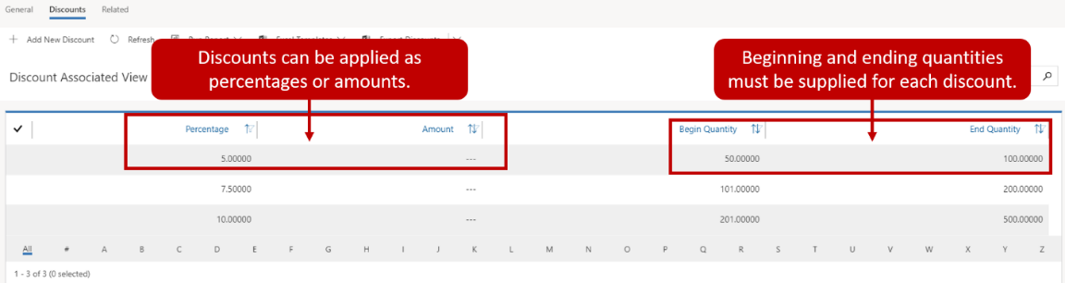
Discount List
To create discounts in the product catalog, select Discount Lists. After you save the discount list for the first time, you can add each discount that's included on it. For each discount, you must specify a start and end quantity, and the discount amount to apply. Discounts can be defined as either percentages or amounts.
Reference Link: https://docs.microsoft.com/en-us/dynamics365/sales/set-up-discount-list

Slide 64
Set up Product
Column | Description
Name | Enter the name of the product that will be used when the product is added to price lists, opportunities, work orders, orders, and so on.
Product ID | Specify the ID of the product. This ID can then be referenced when the product is added to other Microsoft Dynamics 365 records.
Parent | This column is used when the product is associated with a product family. The value can't be changed after the record is saved.
Valid From, Valid To | Specify the date range when the product can be added to items.
Description | Enter a brief description of the product. You can use this column to provide more details.
Unit Group | Define the unit group that defines quantity information that's related to how the product can be sold.
Default Unit | Specify the default unit that will be used for the product, based on the unit group.
Default Price List | Define the price list that will be used for this product by default. Although a product can be associated with multiple price lists, it can have only one default price list.
Decimals Supported | Define the number of decimal places that can be used when the product is added to items. The precision of the Quantity column in the quote, order, or invoice product record is validated against the value in this column if the product doesn't have an associated price list.
Subject | Associate this product with a subject. You can use subjects to categorize your products and filter reports.

Slide 65
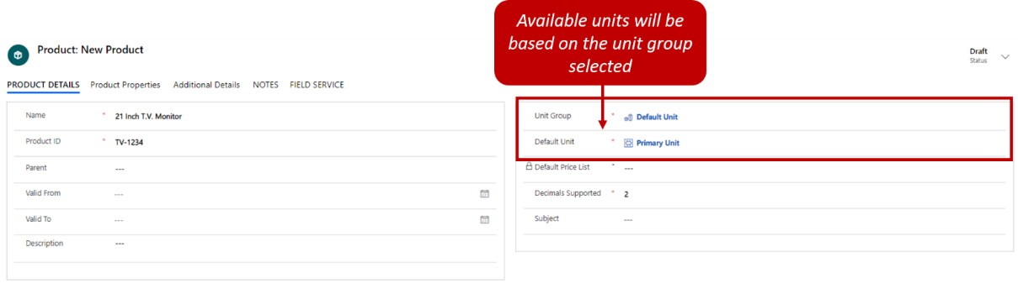
Set up Product
Products in the product catalog represent the individual items and services that an organization sells to its customers. A product might be used to define something physical like a printer, a shirt, or a kitchen appliance. Alternatively, it might be used to define a service that's provided, like a disposal service or consultation fee.
Reference Link: https://docs.microsoft.com/en-us/dynamics365/sales/create-product-sales#create-a-product
When you define a product, you can include the following information:

Slide 66
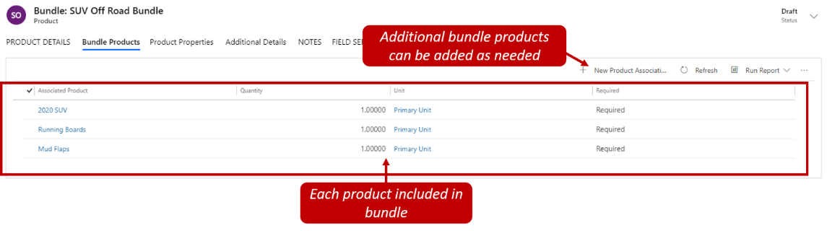
Set up Product Bundle
A bundle is a collection of products that are sold as a single unit. From within a bundle, users can see all the products that are included in the bundle.
Here are some of the scenarios where product bundling can be useful:
You want to pair a top-selling product with a less popular product.
You want to group products in such a way that customers will get more benefits from the full line of products. Examples of this use of product bundles include Microsoft 365 and a digital camera that comes with lenses.

Slide 67
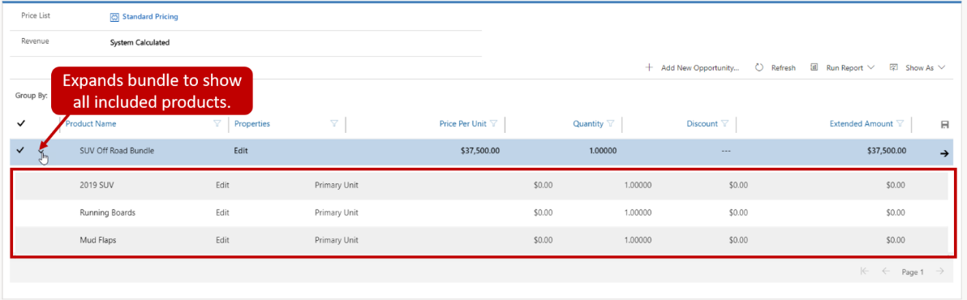
Set up Product Bundle
Although the products in a bundle are typically sold together, specific products in a bundle can be marked as optional. These products can also be sold individually.
After a product bundle has been activated and associated with a price list, it can be added as a line item on records like opportunities, quotes, and orders. Bundles can also be expanded to show the specific items that are included in them.

Slide 68
Set up Product Bundle
Reference Link: https://docs.microsoft.com/en-us/dynamics365/sales/create-product-bundles-sell-multiple-items-together

Slide 69
Set up Product Family
Product families make it easier for sales staff to find products and services in a product catalog. They let you create and categorize similar products together, based on commonalities between them. For example, an auto dealership might have product families like a sports car, truck, and SUV. By combining each car with other cars in the same category, the organization can analyse sales trends by category. It can also analyse product properties across products within the product family. For example, a specific model of the truck might have different interior and exterior colours, or it might be available in two-door or four-door models. Product families let the dealership define those options at the family level so that sales staff can choose the specific options when an individual vehicle is selected.

Slide 70
Set up Product Family
Product families let an organization perform these tasks:
Categorize products in whichever way is most meaningful for them.
Create child products and product bundles within a product family.
Create as many levels of product families as it wants by creating a family within a family.
Reference Link:
https://docs.microsoft.com/en-us/dynamics365/sales/create-product-family

Slide 71
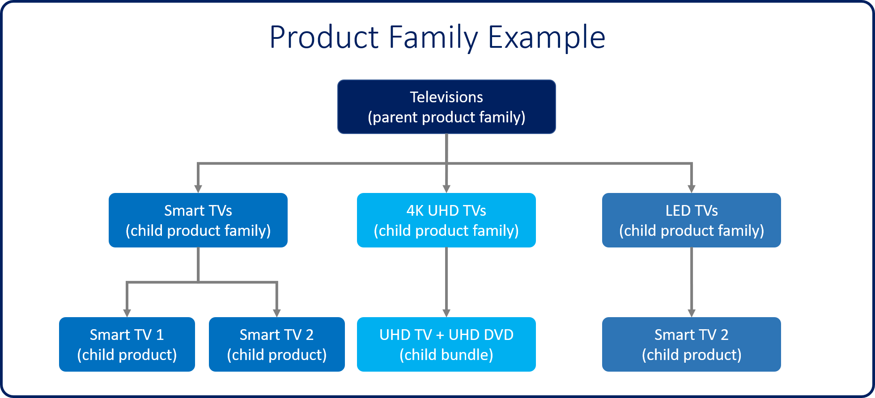
Set up Product Family

Slide 72
Price List
Organizations might sell products and services to many different types of customers. Depending on the type of customer, different pricing options might be used. For example, retail pricing for individual consumers is generally higher than wholesale pricing for distributors, because distributors typically buy in larger quantities and more often. For each product that an organization sells, it might have to define different levels of pricing, depending upon the customer.
Properties can only be added to product families that are in a draft or revision state. To provide the pricing options that organizations require, the Microsoft Dynamics 365 product catalog includes price lists. A price list is best described as a level of pricing that you give to specific types of customers. Most organizations create multiple price lists to support the different selling scenarios that they use.

Slide 73
Price List
Here are some scenarios where multiple price lists might be used:
The organization sells both directly to customers and through a network of resellers. In this case, the organization can create retail and wholesale price lists.
You must create price lists that are used only in a specific marketing campaign.
You must create custom price lists for specific customers, like a contract or preferred customers.
Let's look at a more detailed example, where an organization manufactures mattresses and sells its products to three different types of customers.

Slide 74
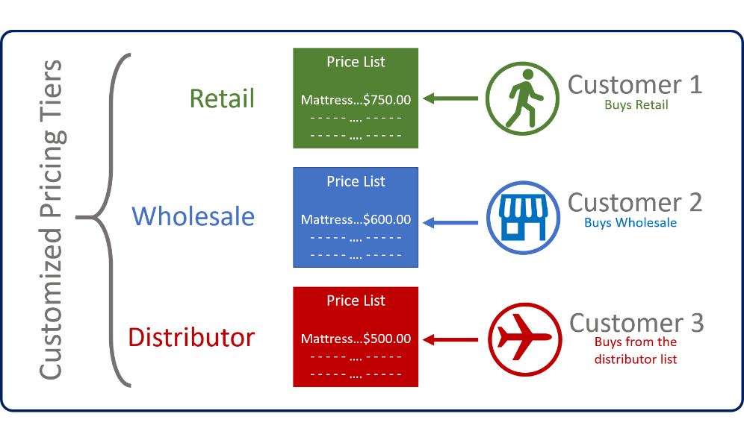
Price List

Slide 75
Price List
Retail customers: Customers who buy directly from the retail website pay $750.00 per mattress.
Wholesale customers: Retail store chains that buy directly from the organization so that they sell the products in their stores pay $600.00 per mattress.
Distributors: Customers who buy directly from the organization so that they can sell the products to other retailers pay $500.00 per mattress.

Slide 76
Price List
To accommodate this scenario, create price lists that are named Retail, Wholesale, and Distributor, and add the mattress to each price list as a price list item. The amount that's charged for the mattress will differ on each price list. Not all organizations need multiple price lists. Some might sell only to retail customers and have only one pricing level. In those instances, only one price list is required, and any product that the organization plans to sell is added to that price list.
Price lists are generally the last item that's set up in the product catalog. They link the unit, product, and pricing details together. Therefore, before you create price lists, make sure that the units and products are defined.

Slide 77
Create Price List
Price lists can be created from the App Settings area of the Sales Hub app. When you create a price list, you must enter a name for the price list, like Retail, or Wholesale. You must also define the currency to use with the price list. By default, price lists use the base currency that's defined for an organization.
Additionally, if the price list will be used for special pricing during a marketing campaign or promotion, you must specify the start and end dates. In this way, you help guarantee that the price list will be used only during the appropriate times.

Slide 78
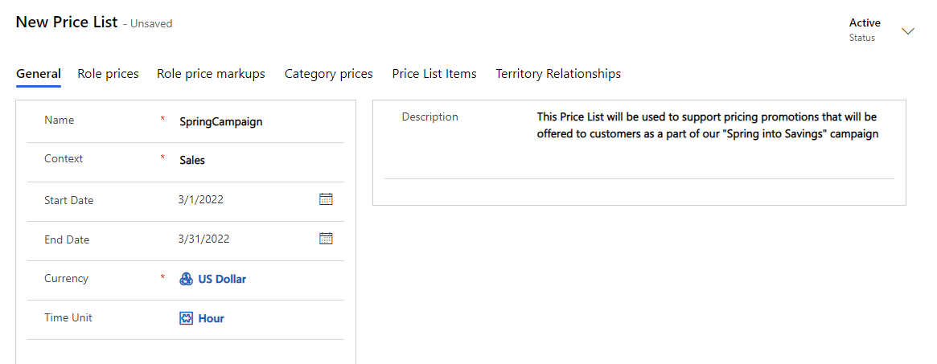
Create Price List

Slide 79
Define Price list Item and Pricing Method
After you've saved a price list for the first time, you can define individual price list line items by selecting the Add new price list item button on the Price list items tab. When an item is first added, you can define the following values:
Price List: Specify the price list to add the line item to.
Product: Define the product from the product catalog to associate the line item with.
Unit: Define the unit of measure to use with the line items, based on the unit group that's associated with the product.
Discount List: Define the discount list to use if the line item requires any volume discounts.
Quantity Selling Option: Define whether the item can be sold whole or in fractional amounts.

Slide 80
Define Price list Item and Pricing Method
Pricing information for each line item is defined on the Pricing tab on the Price List Item page. The first and most important column that you must define is the Pricing Method column. This column defines the actual price of the item for this price list. The following options are available:
Currency Amount: Select this option to ignore a product's list price in the product catalog and manually enter a different price for this pricelist.
Percent of List: Select this option to calculate a product's price on the price list as a percentage of its list price.
Percent Mark-up - Current Cost: Select this option to add a percentage mark-up on top of the current cost that's entered in the product catalog.

Slide 81
Define Price list Item and Pricing Method
Percent Margin - Current Cost: Select this option if the price that's offered on the price list should yield a percentage margin of the current cost.
Percent Mark-up - Standard Cost: Select this option to add a percentage mark-up on top of the standard cost that's entered in the product catalog.
Percent Margin - Standard Cost: Select this option if the price that's offered on the price list should yield a percentage margin of the standard cost.

Slide 82
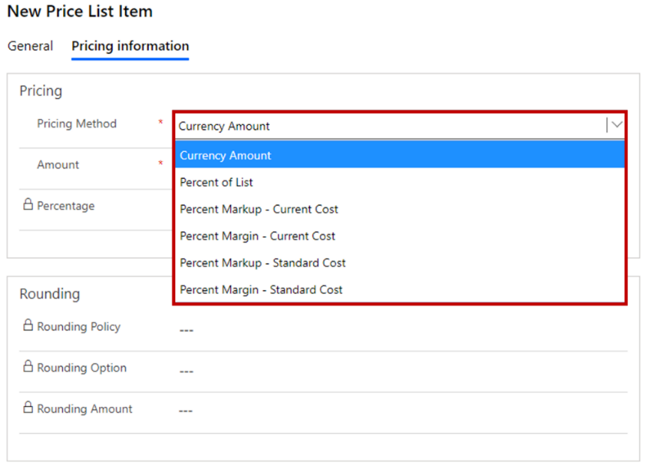
Define Price list Item and Pricing Method

Slide 83
Define Price list Item and Pricing Method
Note: To calculate the Amount based on the Pricing method, “List Price”, “Current Cost” and “Standard Cost” fields of Product are being used.
List Price: This is the ‘listed’ price. You may still choose to have mark-up over it – which can be defined in the pricing method.
Current Cost: This is the current cost of an item, which is usually updated each time a new shipment is received.
Standard Cost: This is the standard cost of an item, which is updated periodically, but not necessarily each time a new shipment is received. It is not equal to the actual cost of the item.
Reference Link: https://docs.microsoft.com/en-us/dynamics365/customerengagement/on-premises/developer/product-pricing-methods?view=op-9-1

Slide 84
Inactivating Price Lists
When a price list is no longer valid, it can be inactivated by selecting the Deactivate button on the command bar of the price list. For example, a company had an introductory price list for a product launch. After several months, the introductory offer is over, and the price list is no longer valid. In this case, you can inactivate the introductory price list so that it can't be applied to any products.
Reference Link: https://docs.microsoft.com/en-us/dynamics365/sales/create-price-lists-price-list-items-define-pricing-products

Slide 85
Re-parenting a Product
To organize your company's product catalog better, you may want to change the parent of an existing product record so the child products inherit the appropriate product properties. You can change the parent of an existing product, bundle, or family to a new parent or delete an existing parent.
To change the parent of a product, bundle, or family, open the respective record, and in the Parent field, select the new parent record. To delete the parent, just remove the parent record from the Parent field.
Things to consider when changing parent:

Slide 86
Re-parenting a Product
Products that are re-parented can't be reverted. When a product is re-parented, the properties inherited from the previous parent are lost. Thus, you can't revert the properties of the re-parented product to the last active version of the product.
You can only select a product family as a parent.
You can only set product families that are in the Under Revision, Draft, or Active state as a parent.
You can only change or remove the parent from records that are in the Under Revision or Draft status.
For an Under Revision record, only an Under Revision or Active record can be selected as its parent.
For a Draft record, only an Under Revision, Draft, or Active record can be selected as its parent.

Slide 87
Re-parenting a Product
When you re-parent an existing record, all the existing inherited properties of the record and its child records are removed, and the new properties of the new parent (if any) are added.
For example, think of a TV that was previously classified as "Plasma." The organization decides it’s better to organize TVs as Smart vs Non-Smart TVs. They decide to move it from the "Plasma" family to the "Smart TV" family. A new set of properties relating to Smart TV are added and Plasma properties are removed from the parent.
Reference Link: https://docs.microsoft.com/en-us/dynamics365/sales/change-product-parent

Slide 88
Product Properties
Another advantage of product families is that you can define properties to help distinguish products. For example, a property can be used to offer size or color options for shirts that belong to the same family.
Properties can be defined at the family level only when the family is in a draft or revision state. To define properties, select the Add New Property button. Any child products, bundles, or child families will automatically inherit the properties from their parent family.
When a property is created, you must define the following details:

Slide 89
Product Properties
Name: Enter the name of the property that will be presented to users when they set it.
Read-Only: Specify whether users can edit the property.
Required: Specify whether a value must be defined for the property.
Hidden: Specify whether the property will be hidden from users when it's consumed.

Slide 90
Product Properties
For each property that's defined, a data type must be defined on the Properties tab. The data type determines the type of data that can be captured for the property. The data can be a choice, a decimal number, a floating-point number, a single line of text, or a whole number. Depending on the data type that's selected, additional options might be available for the property. For example, a property that defines the colors that a car line is available in might to be set to a data type of choice. After the record is saved, each color option must be added as a property choice item.

Slide 91
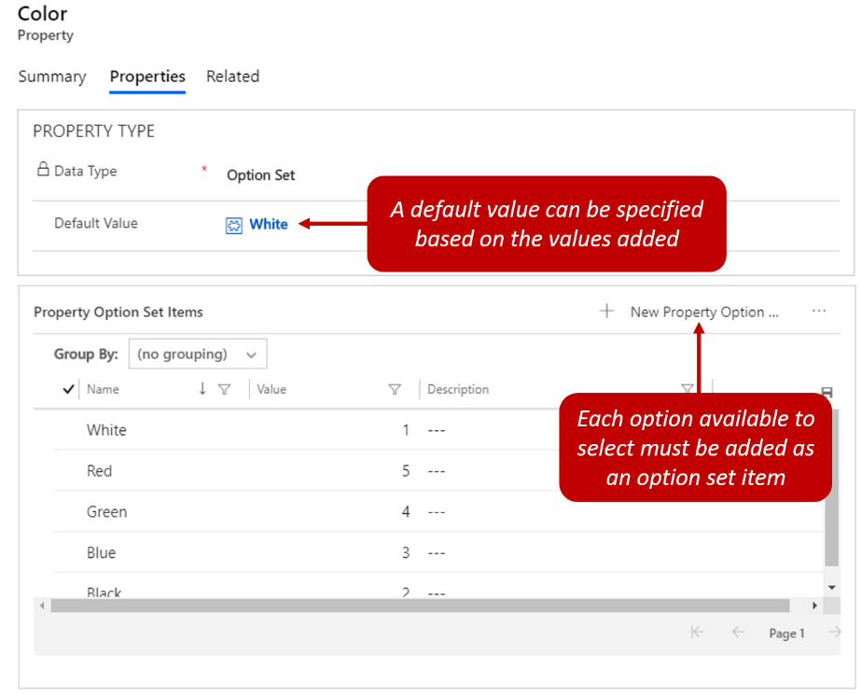
Product Properties

Slide 92
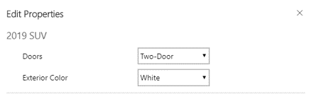
Product Properties
When individual products are added to items like opportunities, quotes, and orders, users can define the available values for each property that's defined for the product family. Just select the Edit Properties button in the Line items sub-grid.
Reference Link:
https://docs.microsoft.com/en-us/dynamics365/sales/use-properties-describe-product https://www.inogic.com/blog/2021/03/enhanced-experience-for-product-properties-in-dynamics-365-crm/

Slide 93
Product Relationship
Product relationships can be used to “link” products for a variety of purposes including up-sell, cross-sell, accessories or substitutions. These relationships can then be used to suggest products as we create opportunities, quotes etc.
Up-sell – An up-sale would be any improvements/additions someone might want to buy. In terms of my caravan purchase, this could include many items such as alloy wheels or a higher specification of kitchen appliances.
Cross-sell – Cross sales are any additional products someone might want to buy. For example, someone who recently bought a caravan may be interested in picnic chairs, a cycle carrier or a BBQ.

Slide 94
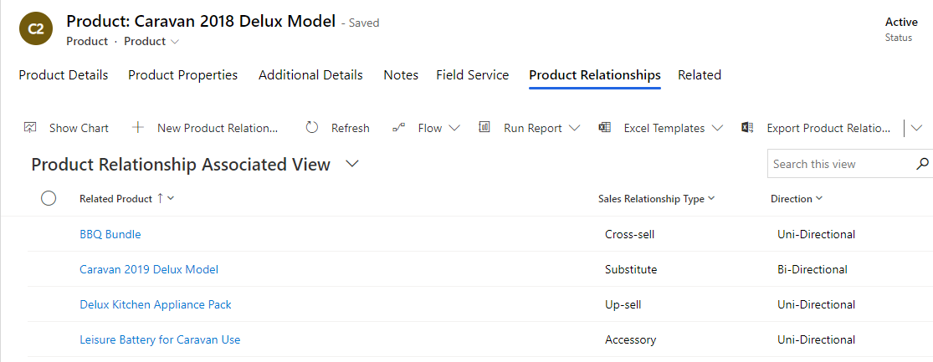
Product Relationship
Accessory – these are anything additional I could use in conjunction with the product. In my caravan example, maybe an awning, gas bottles or a leisure battery might fall into this category.
Substitute – these are items that could be swapped. With my caravan purchase, maybe I could substitute a standard caravan for a deluxe one. Or possibly swap the 2018 model for 2019 one.

Slide 95
Product Relationship
With each related product, you can also define if the relationship is one way or both ways. (Uni-directional to bi-directional.) For example someone who bought a caravan might be open to a cross-sell to a BBQ. But someone who bought a BBQ is unlikely to immediately need a caravan! Meaning this would be a uni-directional sales relationship.
To give another example, someone buying some picnic plates might be interested in some picnic bowls. And someone buying some bowls might be interested in plates. This product relationship would therefore be bi-directional.
When adding products to an opportunity we have the option to look for suggestions (see below)

Slide 96
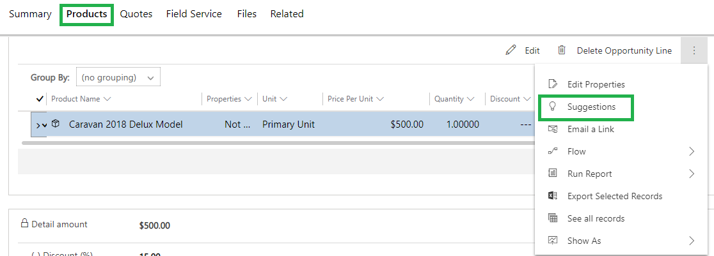
Product Relationship

Slide 97
Product Relationship
Clicking suggestions will show all of the products related to the caravan and give me an option to quickly pick which items to add to the opportunity.
Note: The suggestions are all related products that are available in the price list (as price list items) that are assigned to the opportunity. So, in my example, all of the items will exist in the Caravan and Camping Equipment price list. This fact might force a little planning when considering how to best organize your product catalog/price lists.
Below you can see what the suggestions screen will look like. As you hover over each suggestion an option appears to pick that item. When you click “Add to List” all of the “picked” items will be added to the opportunity.

Slide 98
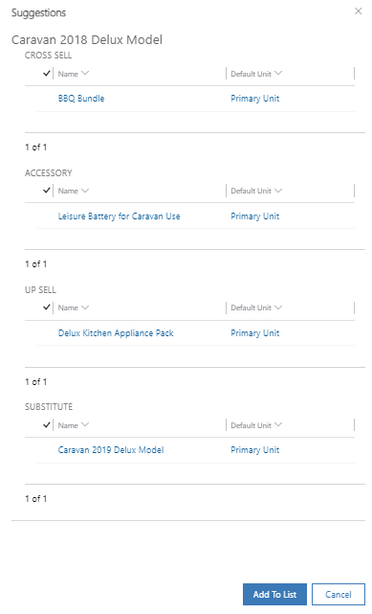
Product Relationship

Slide 99
Product Relationship
You can pick the items and select “Add to list” to add the list of products on the opportunity.
Reference Link: https://docs.microsoft.com/en-us/dynamics365/sales/define-related-products-increase-chances-sales

Slide 100
Publishing, Cloning, Revising, and Retiring Products
By default, product records are created in a draft state. While a product is in a draft state, sales staff can't add it to items like opportunities, quotes, or orders. When you're ready to sell a product, you must publish it.
Sometimes, a product that's being created resembles an existing product but isn't the same. To save time when you create these products, you can select the Clone button on the command bar to make a copy of the existing product. When a product is cloned, the product details are copied to a new product record. The new product record can then be edited as needed to reflect the specific details for that product.

Slide 101
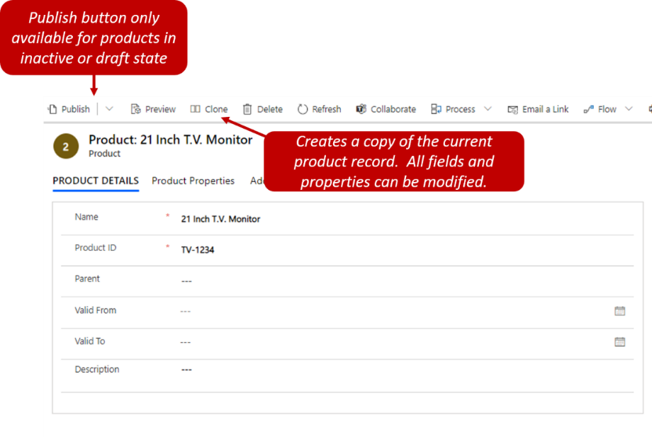
Publishing, Cloning, Revising, and Retiring Products

Slide 102
Publishing, Cloning, Revising, and Retiring Products
After a product is published, changes (like changes to the product properties) can't be made. If changes to the product properties are required, you must select the Revise button on the command bar to return the product to a draft state. Changes can then be made to the product properties. After you've finished making changes, you must publish the product again so that it's available to users.
If your organization no longer sells a product, you can select the Retire button on the command bar. In this way, you can make sure that the product is no longer available for sales staff to use. When a product is retired, it's inactivated and can no longer be added to items like opportunities and orders. If a product that was previously retired must be available again for any reason, it can be reactivated. It's then moved back to a published state.

Slide 103
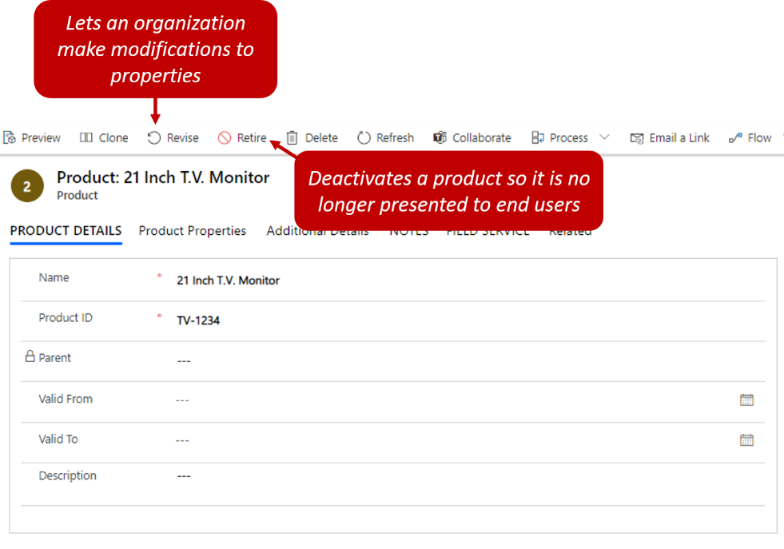
Publishing, Cloning, Revising, and Retiring Products

Slide 104
Publishing, Cloning, Revising, and Retiring Products
Reference Links:
https://docs.microsoft.com/en-us/dynamics365/sales/publish-product-bundle-make-available-selling
https://docs.microsoft.com/en-us/dynamics365/sales/revise-product
https://docs.microsoft.com/en-us/dynamics365/sales/clone-product
https://docs.microsoft.com/en-us/dynamics365/sales/retire-product

Slide 105
Delete a Product family, product, or bundle
To stop selling a product, bundle, or family, delete it. If you delete a parent family, its child products, families, and bundles are also deleted.
Reference Link: https://docs.microsoft.com/en-us/dynamics365/sales/delete-family-product-bundle

Slide 106
View a Product Hierarchy
In addition to grouping similar items, product families create a hierarchy that provides a visual snapshot of the products that an organization sells. Therefore, it's easy to see what products are available to sell and how they're connected.

Slide 107
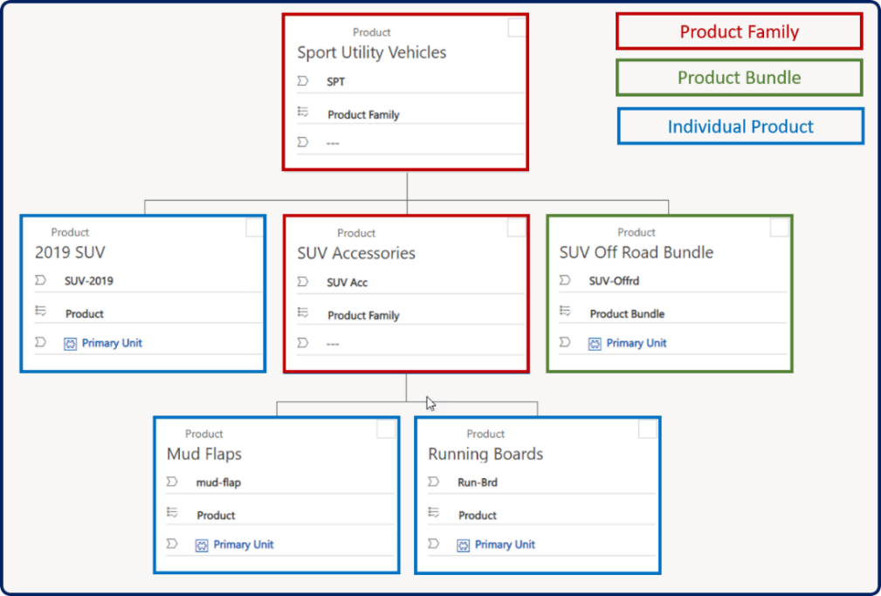
View a Product Hierarchy

Slide 108
View a Product Hierarchy
Reference Link:
https://docs.microsoft.com/en-us/powerapps/maker/data-platform/visualize-hierarchical-data?context=/dynamics365/context/sales-context

Slide 109
Price Calculation and Product Bundle
Typically, the pricing of products in bundles is different than for individual products. You can set a total, potentially discounted, the price for the bundle. Or—if the bundle includes optional products—you can add those products to the price list as price list items.
When a product bundle is added to an opportunity, quote, order, or invoice, a required product in the bundle uses the bundle price for price calculations. When the bundle added to the opportunity, quote, order, or invoice includes optional products, the total price is calculated by adding the total price of the optional products to the price of the product bundle.
Let's understand this with an example. You have a product bundle priced at $500, with the following products included in it:

Slide 110
Price Calculation and Product Bundle
This bundle will be added to an opportunity with a price of $500.
Products in the bundle | Unit | Price per unit
Required product A | 5 | $50
Required product B | 5 | $70

Slide 111
Price Calculation and Product Bundle
Now, let's see how the calculation differs if the product bundle priced at $500 includes the following required and optional products:
Product bundle | Unit | Price per unit
Required product A | 5 | $50
Required product B | 5 | $70
Optional product C | 5 | $40
Optional product D | 5 | $50

Slide 112
Price Calculation and Product Bundle
When this bundle is added to an opportunity, its price will be calculated as follows:
Product bundle price | + | Sum of optional products' price | Total
$500 | + | (5 × $40) + (5 × $50) = $450 | $950

Slide 113
Price Calculation and Product Bundle
When you try to update a product that's a required item in a bundle that has been added to an opportunity, quote, order, or invoice record, you might get an error in Dynamics 365 Sales: "You can't update this bundle item because it's a required product in the bundle."
Because the pricing-related fields for a product that's required for the bundle aren't used in price calculations, you can't modify these fields. The pricing-related fields are Unit, Existing Product, Pricing, and Price per Unit, Volume Discount, Quantity, Amount, Manual Discount, Tax, Extended Amount, Product Type code, Transaction Currency, and Parent Bundle. You can modify fields other than these pricing-related fields.

Slide 114
Price Calculation and Product Bundle
Reference Link:
https://docs.microsoft.com/en-us/dynamics365/sales/pricing-product-bundles

Slide 115
Enhance Experience for Adding Products
Add Products to an Opportunity using enhanced “Add Products” button is available now for the salesperson for adding multiple products.
Reference Links:
https://docs.microsoft.com/en-us/dynamics365/sales/add-products-enhanced-experience
https://www.inogic.com/blog/2020/05/productivity-booster-enhanced-experience-for-adding-line-items-products-with-2020-release-wave-1/
https://www.inogic.com/blog/2021/05/enhanced-experience-for-adding-line-items-products-with-2021-release-wave-1/
https://docs.microsoft.com/en-us/dynamics365/sales/enable-enhanced-add-product-experience?tabs=SE#enable-or-disable-the-enhanced-experience

Slide 116
Enhance Experience for Adding Products
Add Products to Quote/Order/Invoice using enhanced “Add Products” button is available for the salesperson for adding multiple products.
Reference Link: https://docs.microsoft.com/en-us/dynamics365/sales/add-products-qoi-enhanced
You can customize the Add Products dialog box as per your wish.
Reference Link: https://docs.microsoft.com/en-us/dynamics365/sales/customize-add-products-dialog-box?tabs=SEAddColumns%2CSEProductColumns

Slide 117
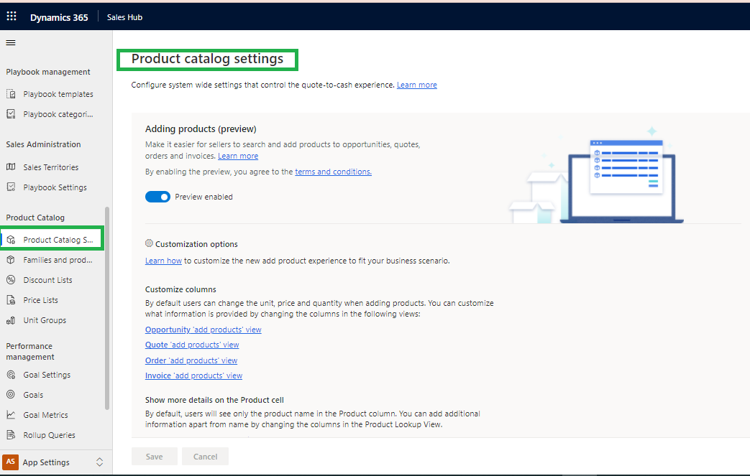
Configure Product Catalog Settings

Slide 118
Configure Product Catalog Settings
Reference Link:
https://docs.microsoft.com/en-us/dynamics365/sales/configure-product-catalog-settings

Slide 119
Price Calculation for Opportunity, Quote, Order, and Invoice records
Reference Link:
https://docs.microsoft.com/en-us/dynamics365/sales/price-calculation-opportunity-quote-order-invoice-records

Slide 120
FAQs
1. Is it compulsory to always follow the typical OOB sales process path from Lead to Invoice?
It is not compulsory it is up to your business requirement, for e.g. If your organization would not like to create lead entity record and start the business from Opportunity entity itself then they can do so.
2. From how many places lead records can be created in Dynamics 365?
There are many places as mentioned below:
Manually (Sales hub-->under Sales area-->navigate to Leads-->click on +New from command bar)
Converting email activities to leads
Bulk importing leads
For more details go through below link:
https://docs.microsoft.com/en-us/learn/modules/manage-leads-dynamics-365-sales/2-create-leads

Slide 121
FAQs
3. Can I have more than one BPFs on entity record and how to select the desired BPF amongst all?
Yes, you can create multiple BPFs. for switching over the BPFs on entity record form you need to click on “Process” button from command bar after it click on “Switch Process” to display all the BPFs.
NOTE: You can have maximum up to 10 active business process flows per table/entity.
For more details go through below link:
https://docs.microsoft.com/en-us/power-automate/business-process-flows-overview

Slide 122
FAQs
4. While qualifying lead record Account not created what must be the reason?
Check while qualifying if Company name field filled on lead record.
5. Can I change the OOB lead qualification experience? What happens when I try to qualify if I do so?
Under Sales hub Change the area to App Settings
Under General settings --> “Lead + Opportunity Management” -->Go to Lead Qualification” by default this setting is Yes means on qualifying the lead Account, Contact and Opportunity created but if turned off then while qualifying lead record you can choose only those records which you want to create.

Slide 123
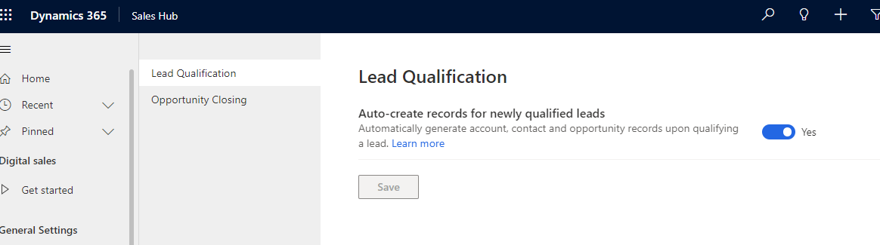
FAQs

Slide 124
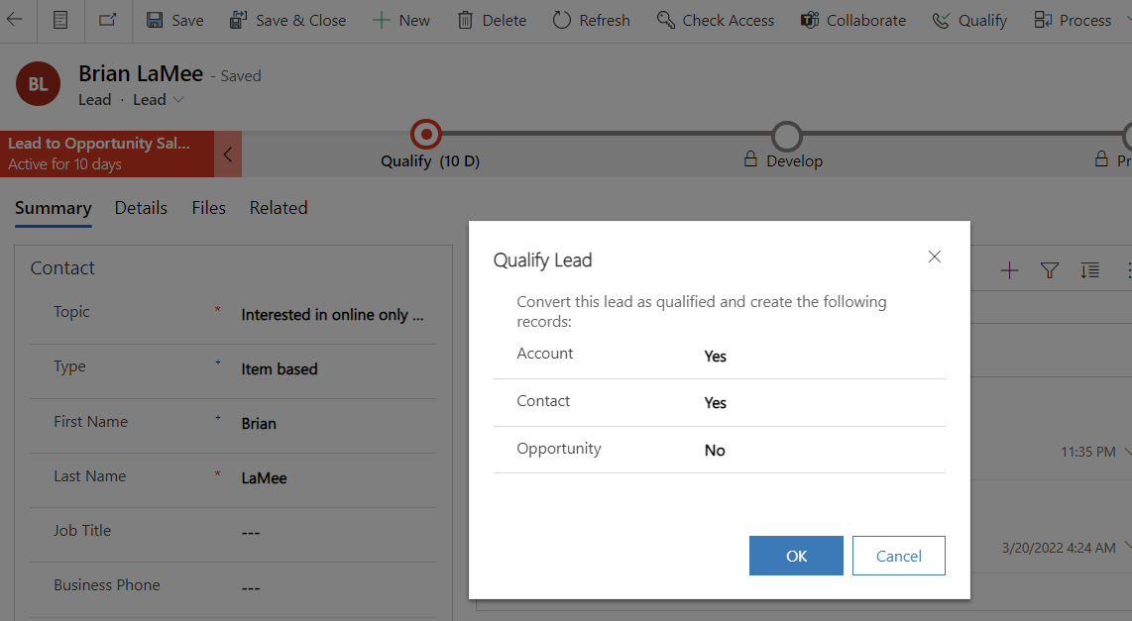
FAQs
When you try to qualify lead you will see below page for option to create or skip record creation.

Slide 125
FAQs
For more details go through below link:
https://docs.microsoft.com/en-us/dynamics365/sales/define-lead-qualification-experience

Slide 126
FAQs
6. What happens when duplicates for Account or Contact are found while qualifying leads?
When qualifying a lead, if a duplicate account or contact is detected while creating new records, a duplicate warning is shown to you.
7. What happens to timeline information (like phone call, email activities etc.) that salesperson created on lead record, when leads are qualified?
When a lead is qualified, timeline activities are displayed in the newly created Opportunity record so that the timeline information is not lost.
8. When clicking on “Close as Won” button I am not able to close the opportunity, what must be the reason?
Verify there are no active or draft quotes associated with the corresponding opportunity. If you have then you must close all the quotes before closing the opportunity.

Slide 127
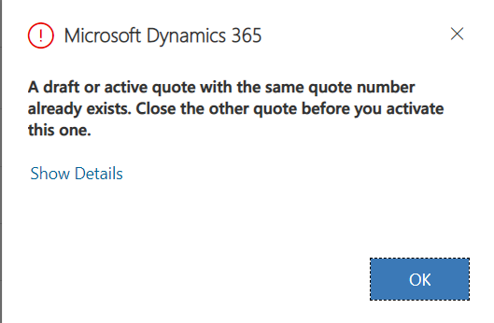
FAQs
9. Can I revise the quote once the Quote is closed as Won?
No, the Revise button is not displayed on Won Quote.
10. I was not able to view Revise button on Quote command bar what must be the reason?
Verify if Quote is activated.
11. Salesperson Closed the quote as it was asked for cancellation by customer afterwards while trying to revise the quote salesperson was experiencing below pop up, what must be the reason?
This is OOB pop up restriction, as you still have draft or active quote associated with same quote number you are not able to do so.

Slide 128
FAQs
12. On Quote record which field is used for storing Account and/or Contact both?
Potential Customer field on Quote is used
13. You need to ensure that estimated revenue for opportunities is automatically calculated. What should you do?
Make sure the Revenue field value set as System calculated
14. When lead is qualified, what happens in terms of BPF stage on lead record?
BPF stage advanced from qualify to develop stage, and at any time you can navigate to opportunity record by clicking on Develop stage.
15. If you do not want to change the ownership of record and yet want to provide the access to other user, which feature you should use?
You can share the record with other user

Slide 129
FAQs
16. While sharing the records from Salesperson A to Salesperson B, permission dialog box opens up with which options?
Read, Write, Delete, Append, Append to, Assign, Share
For more details go through below link:
https://www.inogic.com/blog/2021/08/new-model-driven-app-experience-for-sharing-entity-rows/

Slide 130
FAQs
17. What is the major difference between Assign and Share feature?
Let say if User Paul open the opportunity record and wanted to share this with User Alex so Paul after clicking on share button from opportunity command bar it gets shared but still ownership of record remain under User Paul only.
Note: User Alex has the access depend upon the privileges provided while sharing.
If User Paul assign the record then ownership changed to User Alex, this way User Paul has no longer access to that record as User Alex is the owner.

Slide 131
FAQs
18. If Price list is mandatory then what is the purpose of selecting currency on opportunity record?
To filter the price list while adding products as opportunity products/lines.
19. Can I make Price list optional?
Yes you can make price list optional.
For more details go through below link:
https://www.inogic.com/blog/2019/11/optional-price-lists-new-dynamics-365-crm-wave-2-release-feature/

Slide 132
FAQs
20.Purpose of Recalculate opportunity button?
This button allow you to recalculate the estimated revenue.
21.Is there any way by which I can open the existing closed opportunity?
Yes by using “Reopen Opportunity” button you can open the existing closed opportunities.
22.Can Salesperson add multiple products at a time?
Yes there is setting available, change the area to App Settings-->under product catalog settings-->Turn on the Adding Products (preview) as shown below:

Slide 133
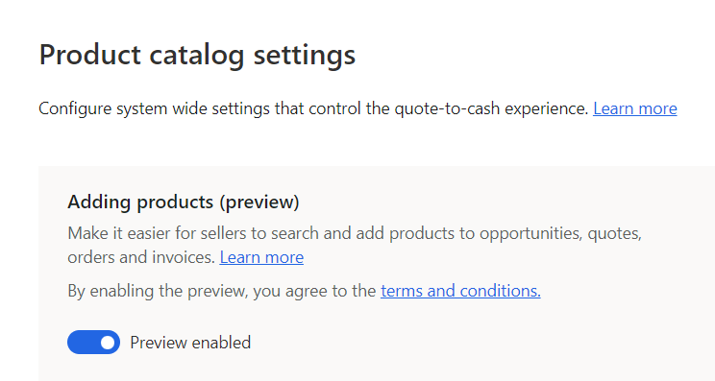
FAQs
NOTE: by default this feature is off you must turn on it by navigating to App settings.
For more details go through below link:
https://www.inogic.com/blog/2021/05/enhanced-experience-for-adding-line-items-products-with-2021-release-wave-1/

Slide 134
FAQs
23.How Adding Products (Preview) feature beneficial for salesperson?
Salesperson can add MULTIPLE line items/products throughout the sales process from opportunity, quote, order, and invoice
24.What are preview features?
Preview features are the features that aren't complete, but are made available on a "preview" basis so customers can get early access and provide feedback. They are not recommendation for production deployment.
For more details go through below link:
https://docs.microsoft.com/en-us/power-platform/admin/what-are-preview-features-how-do-i-enable-them

Slide 135
FAQs
25.What is the concept of write in products?
You may have a need to use write-in products on the opportunity or quote if you want to estimate something that is not in the product catalog (If it is defined in product catalog means that is the Existing product). Write-in products allow you to simply type the name of a product or service and type in the price and it is temporary available only for that particular opportunity or quote.

Slide 136
FAQs
26.Is there any setting responsible for performing System pricing calculation?
Yes, if you navigate to App Settings-->Product Catalog Settings-->You will find “System Pricing Calculation” option is selected by default. That means system uses the inbuilt Microsoft plugins for pricing calculation.

Slide 137
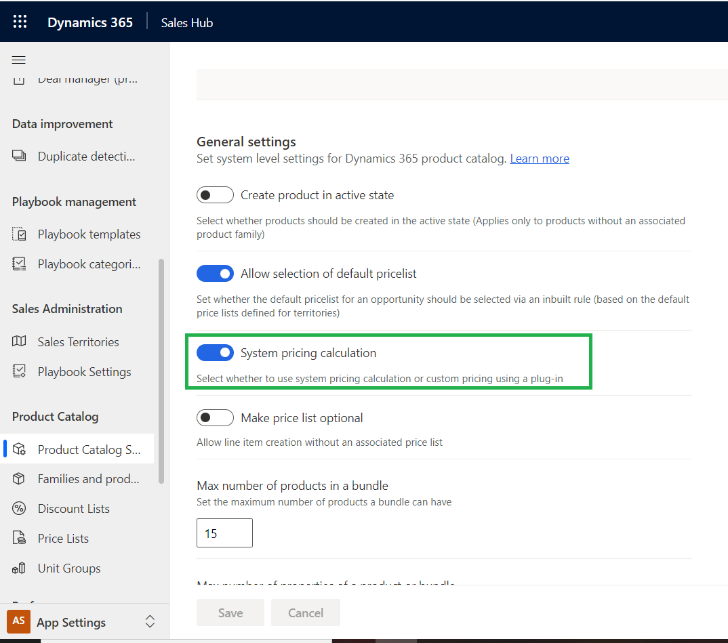
FAQs
NOTE: Disabling this option will require you to then provide custom programming to calculate all the system calculated pricing fields for Opportunities, Quotes Orders and Invoices.

Slide 138
FAQs
27.In the Product Catalog, users have existing product named an iPhone and Bundle named IOS Devices. Now, while adding a new product which one user should select as the parent of a new product?
Neither product not a bundle. Because If the User selects any of the product or bundle as a parent while creating a new product it should give an error message as we can only select a product family as a parent.
28.Can multiple Units will be added to a price list?
No.
29.What would be an ideal scenario to keep in mind for selecting units while adding the product to a bundle?
The unit we are selecting must be the same default unit that we have selected while creating a product.
Otherwise, it will give an error message as “The Product can’t be added to bundle. You have to use a Product unit that belongs to the Unit Group of Product”

Slide 139
FAQs
30.Can user create a product in the system with an active state directly?
To create an active product user need to check if “Create a product in an active state” is enabled in the Product catalog setting.
31.Why user is restricted to add more than three products in the bundle.
“The maximum number of products in a bundle” is set to 3 from product catalog settings.
32.What are the different types available while defining the Discount List?
Percentage and Amount
33. What user should do to change the properties of the existing record?
If the user wants to change the properties of the existing record user should use the revise button on the ribbon bar, it will change the status of the active record to under Revision and let the user change the properties of that record.

Slide 140
FAQs
34. When will be the Publish button is visible on the ribbon bar?
When the record is in the Draft & under Revision, the Publish Button will be displayed on the ribbon bar.
35. Is it possible to publish all the products and Bundles from that product family all at once? If yes, How?
Yes, users can publish all the products and Bundles from that product family all at once using Publish Hierarchy.
36. How user can tell if Products have a hierarchy or not.
Hierarchy symbol is present in front of the products.

Slide 141
FAQs
37.Can the user able to see the hierarchy for the record without opening the actual record?
To see the hierarchy user must select a product record from the list. Once the product is selected View Hierarchy button is visible on the ribbon bar. With a click of that button, the user can see the hierarchy present for that product.
38.If Price list is mandatory, can user add products with different price lists to the same quote?
No
39. What product/company owner would do in case of the product is no longer available for sale?
The product owner will retire that product record.
40.What are the different data types of properties?
Options set, Decimal, Floating Point Number, Single Line of Text and Whole Number

Slide 142
FAQs
41.What are the different sales relationship types?
Up-Sell, Cross-Sell, Accessories, Substitute
42.When the product that the user selects in Related Product where it will be shown as a recommendation for the existing product?
When the Direction of the product relationship is selected as Uni-Direction.
43.Can the product come up with more than one price list item?
Yes
44.Is it compulsory to assign a discount list to a product?
No
45.Can product have multiple price lists with different currency?
Yes, Product can have multiple price list with different currency (that is product can have multiple currencies set), but as you know Quote/Order/Invoice doesn't support multi-currency at a time, 1 Quote can only use 1 Currency selected as lookup.

Slide 143
FAQs
46.Is it compulsory to set a currency on a price list?
Yes.
47. How many currencies can be set on a price list?
Multiple currencies are available to select, but we select only one currency at a time.
48.How many types of prices can be defined on a product?
One or more prices we can define on a product.
49.What happens to the related records when we delete a currency?
When we delete a currency it shows an error message as currency is associated with the related record and can't be deleted.

Slide 144
FAQs
50.Where I will find the “List Price”, “Standard Cost” and “Current Cost” fields on Product?
By default, it is added to the “Project Information” form of the Product entity. You can add the same on the Product main form from make.powerapps.com
51.Can we add the Product into the bundle after revising it?
No, you can only revise the Product Properties.
52.Can we have two properties with the same data type in Product?
Yes.

Slide 145
FAQs
53.What happens when you retire Product Family?
All Products/Product Bundles associated with Family get retired if not having any dependencies.
54.Can you retire the Product which is added on Opportunity/Quote/Order/Invoice?
You can retire the Product even if added on Opportunity/Quote/Order/Invoice.
55.Can you add the Product Family record on the Opportunity/Quote/Order/Invoice?
No, we can only add Products with Product Structure = Product/Bundle.

Slide 146
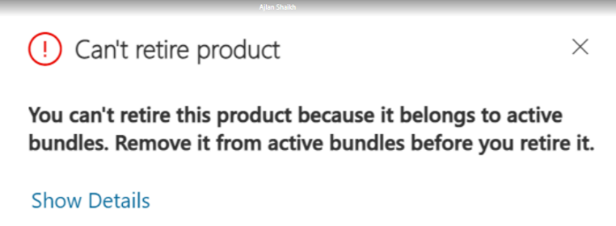
FAQs
56.What happens in terms of properties when you select Product Family record as Parent on Product?
Properties added to the selected Product Family get automatically copied/ inherited on the Product.
57.Can you add/change the Parent on Product once the Product is published?
No. the Parent field gets Read Only. And you can do the same by revising the Product using the “Revise” button.
58.Can we retire the Product if it’s associated with bundle?
It is restricted as below error message displayed:

Slide 147
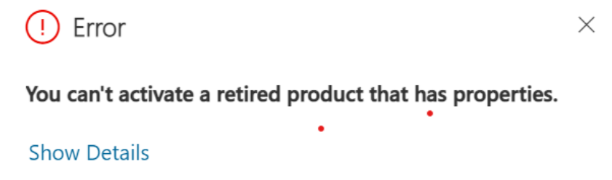
FAQs
59.What happens when you try to reactive the retired product that has Product Properties associated?
It is restricted as below error message displayed:
60.If I have Currency on Product as US dollar, then can I select the Price list of different currency (e.g. Rupees) in Default Price list of same product?
Yes
61.Where you can see the Product Relationship you created for the Product?
You can see the Product Relationship record on the Opportunity Line/Quote Line/Order Line/Invoice Line sub-grid added on Opportunity/Quote/Order/Invoice.

Slide 148
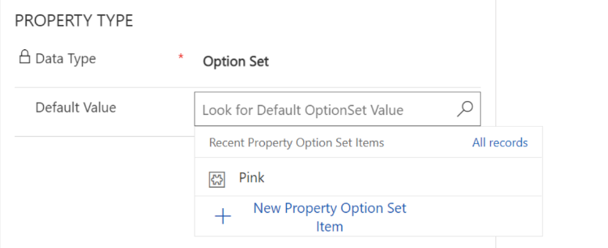
FAQs
62.What type of Product you can set as Parent on the Product/Bundle?
We can set only Product having Product Structure = Product Family as a Parent independent of its status.
63.What will be the currency when a new Product gets created?
Default currency will be set based on the selected CRM region/country you selected while creating environment.
64.Can we add existing option set properties of Product to another product?
For example: I created “Pink” default value as an Option set property for 1 product, can I use the same on other product?

Slide 149
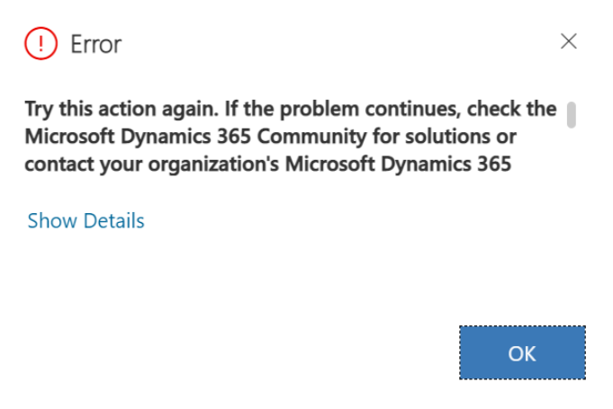
FAQs
No, below error get displayed:

Slide 150
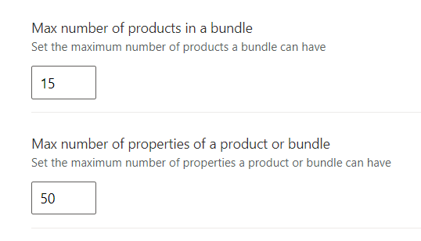
FAQs
By default, what are the maximum number of Products we can add in the bundle and Properties we can add for Product or bundle?
Under App Settings-->Product Catlog Settings you will find the default set value as below:

Slide 151
Thank You

